Slide 1
LED Audio Visualizer
Vaidas Karnickas (2012161176)
Simonas Jokubauskas (2012161175)

Slide 2
Goal
To make an animated audio visualizer
based on Arduino using:
64 Diffused LED’s
16 100 OHM Resistors
Wire
Craft Wire
PCB’s
Acrylic Board for the casing

Slide 3
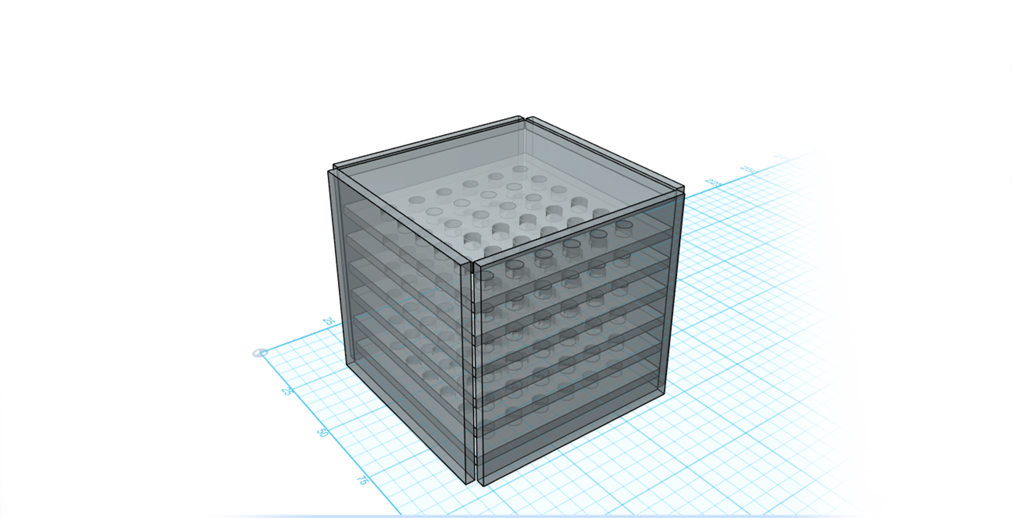
Goal
To make an animated audio visualizer
based on Arduino using:
64 Diffused LED’s
16 100 OHM Resistors
Wire
Craft Wire
PCB’s
Acrylic Board for the casing

Slide 4
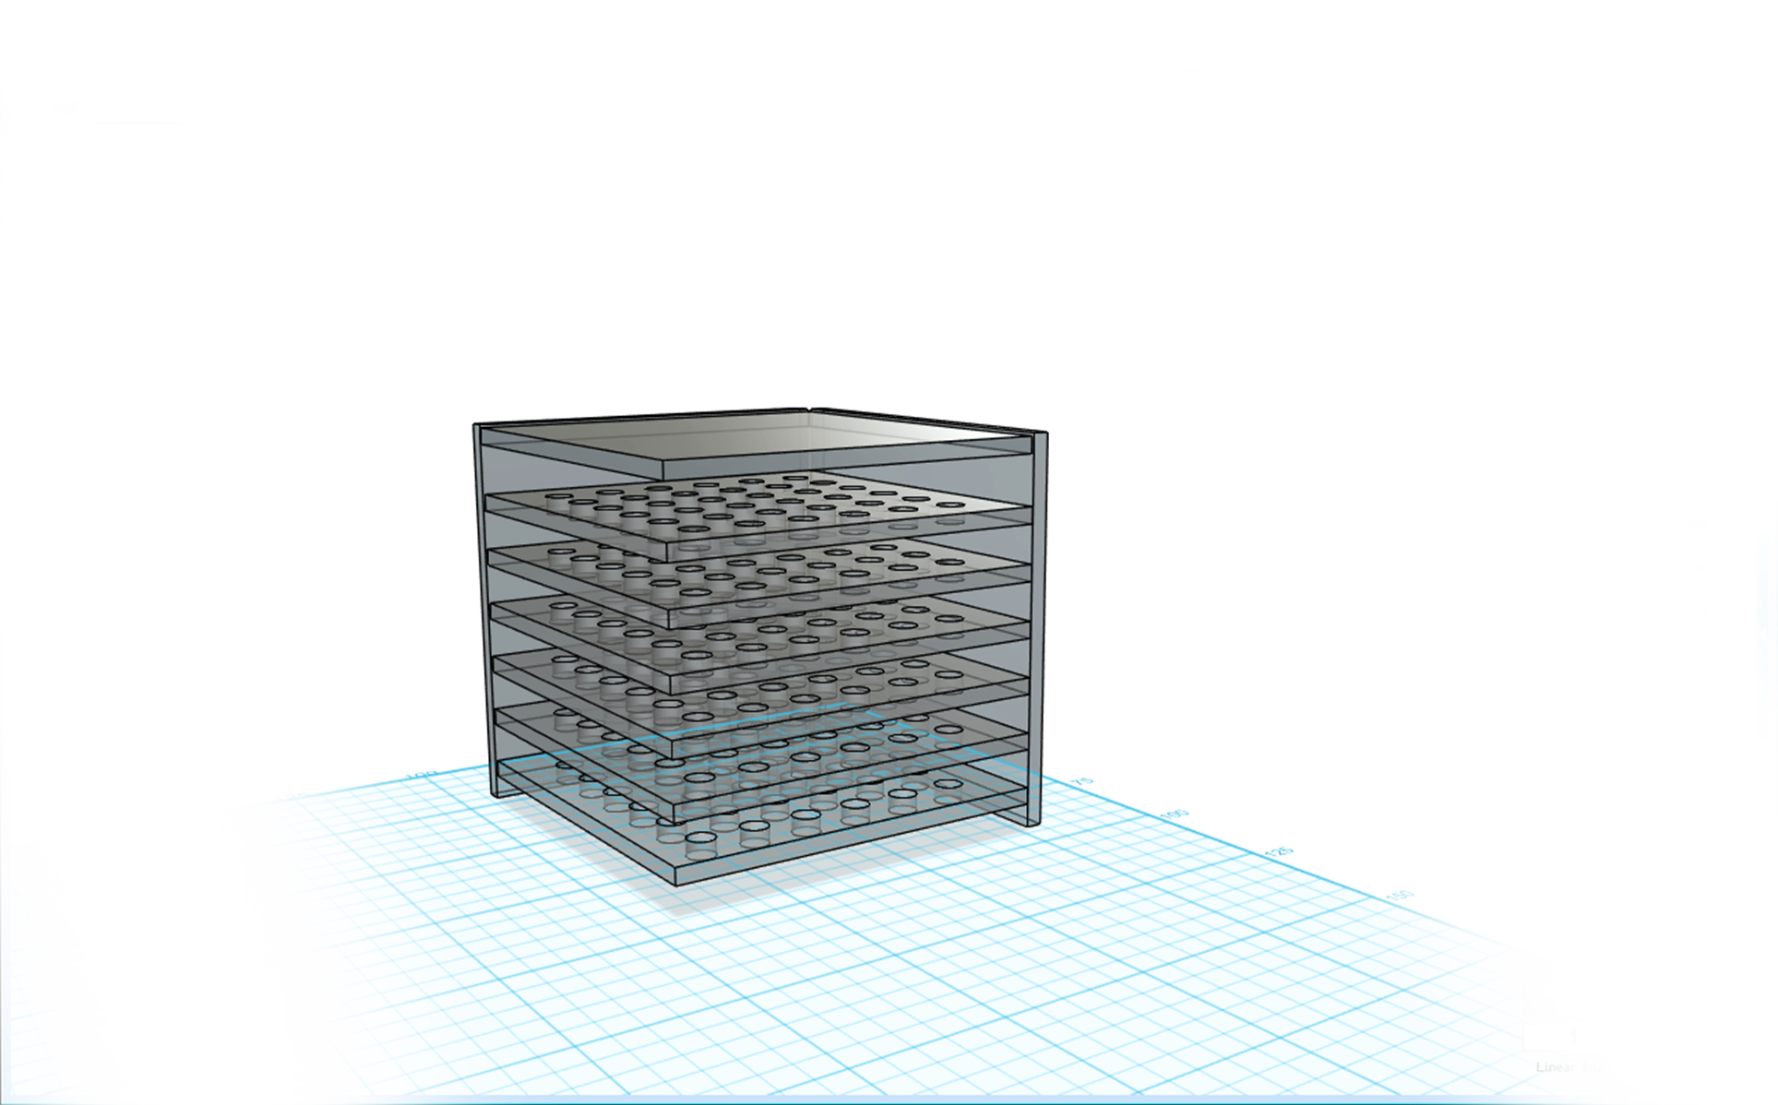
Problems We Encountered
Majority of the parts did not arrive, and the LED’s we have received, were not the ones we ordered.
Because of these issues, the finished project does not look very elegant.

Slide 5
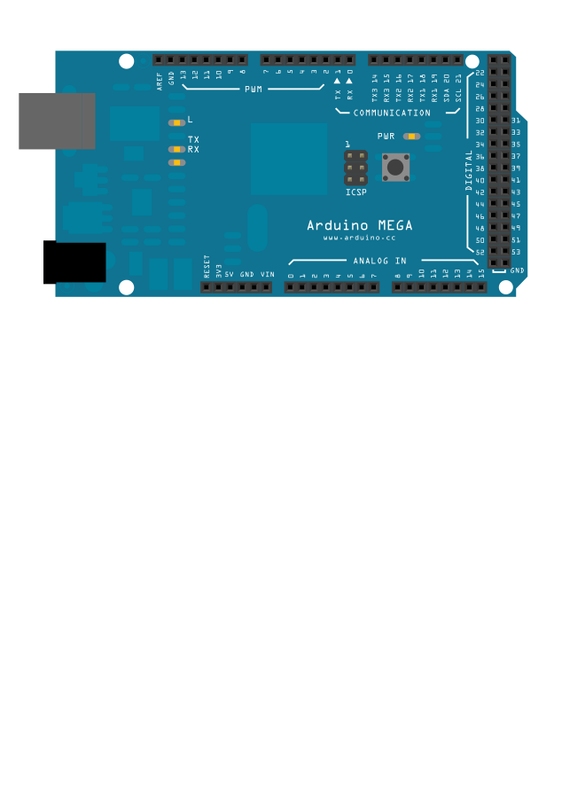
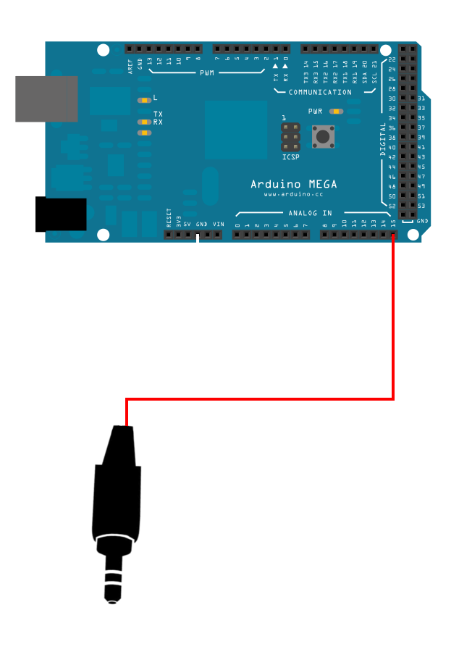
Principle of Working
Both the LED’s array and the audio input is controlled by the Arduino board.

Slide 6
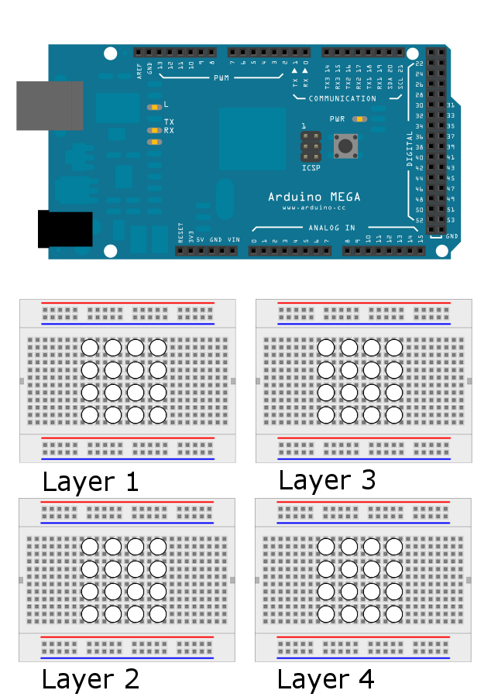
Principle of Working
Audio input is processed through one of the analog and ground pins, utilizing one channel (mono) audio.

Slide 7
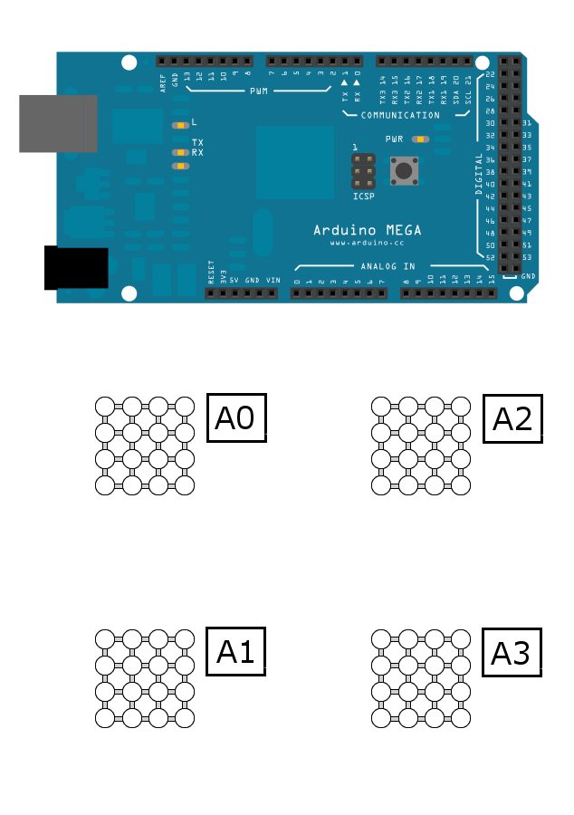
Principle of Working
Four more analog pins were used to control the layers of the LED array.

Slide 8
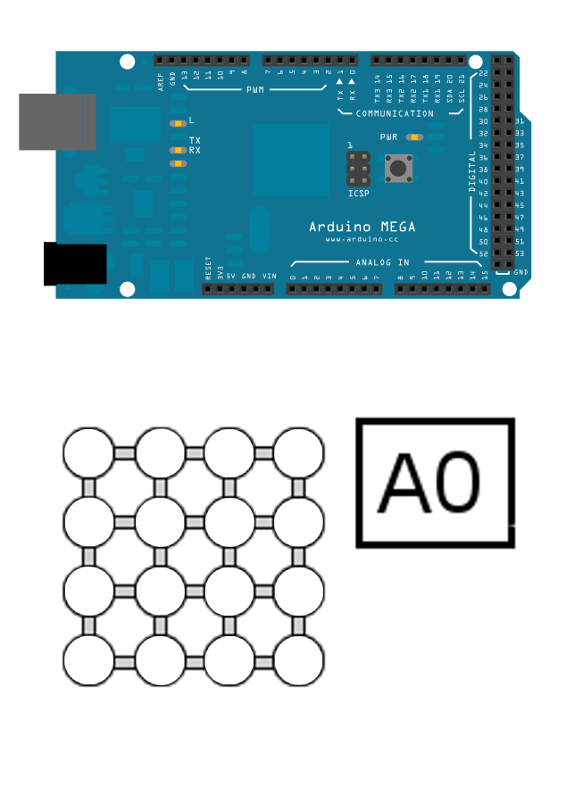
Principle of Working
Each layer has all the LED’s connected by anodes (positive leads)

Slide 9
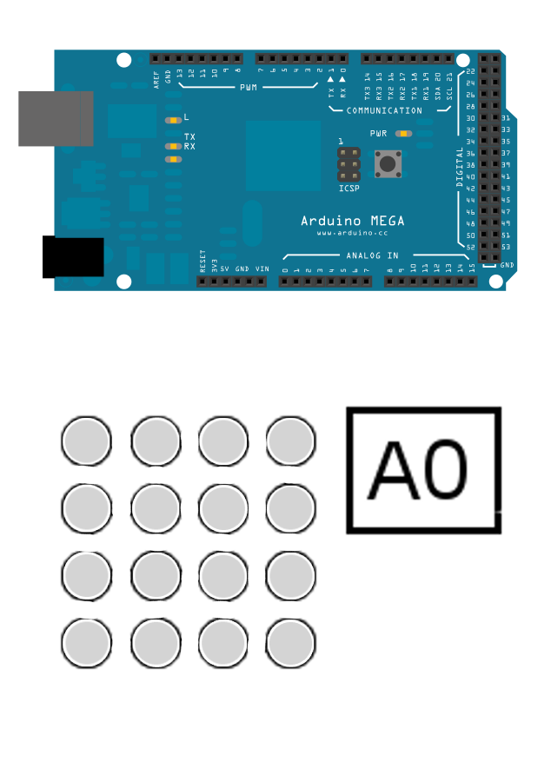
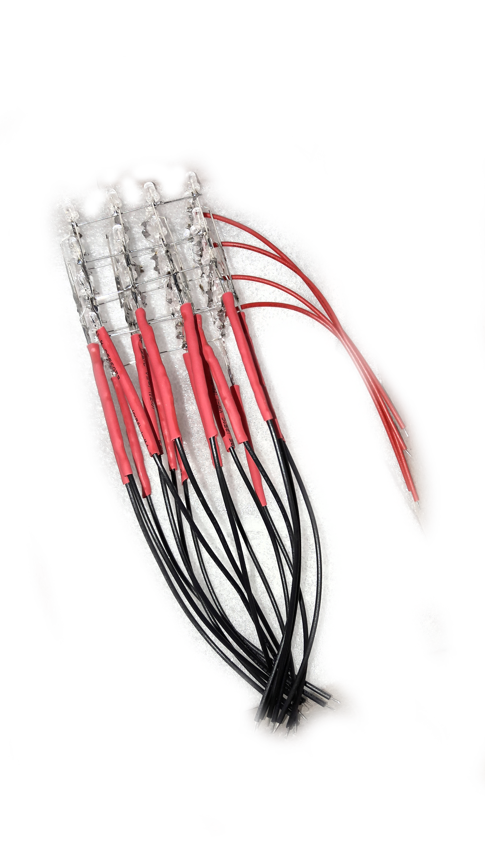
Principle of Working
Each individual column is connected by the cathodes. This allows the control of any individual LED.

Slide 10
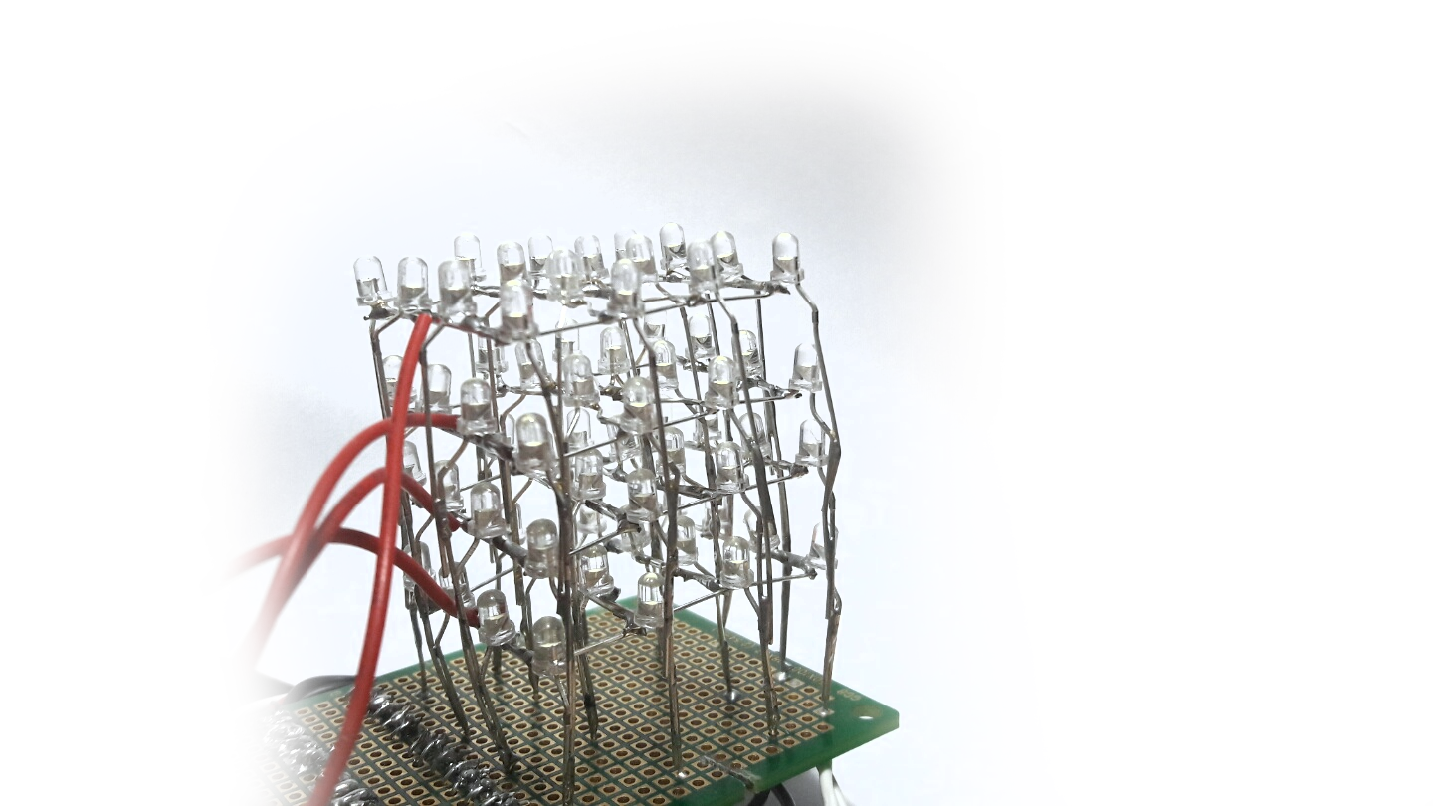
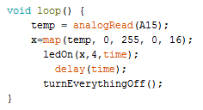
Led Control And Animations
Each individual LED can be controlled. However, only one LED in the column can be controlled individually.
For one of our animations this is not a problem since we utilize 16 columns as 17 different animations.

Slide 11
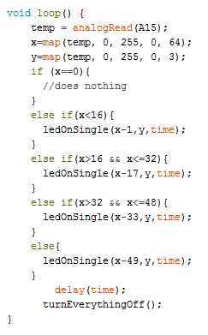
Led Control And Animations
For another animation, we have 65 different animations that utilize multiplexing.

Slide 12
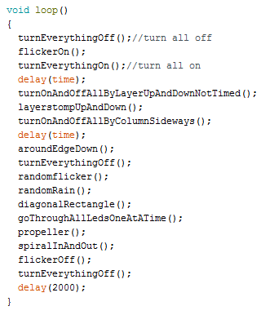
Led Control And Animations
We also have a separate animation set that utilizes various functions.

Slide 13
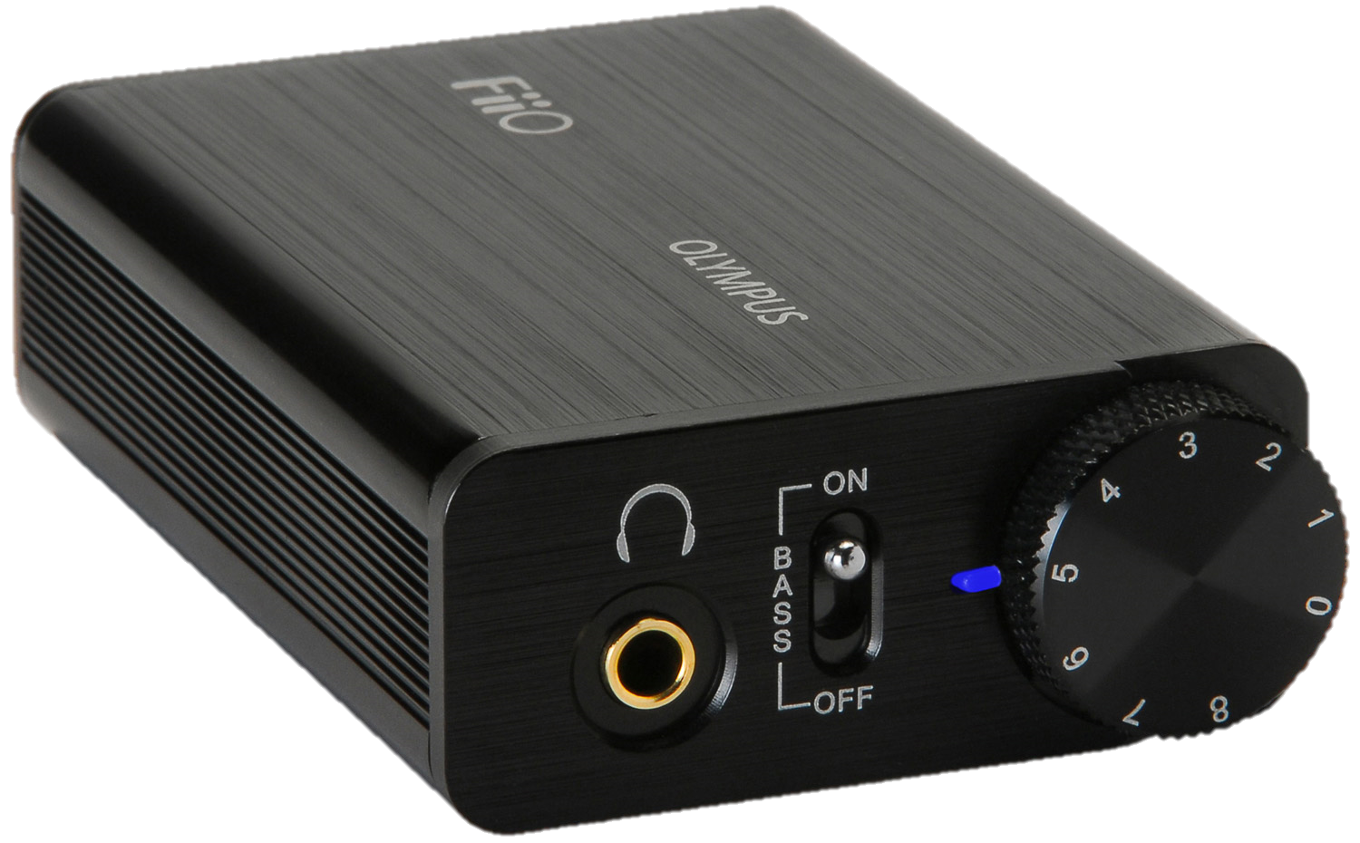
Demo
The short demonstration will be powered through the FiiO e10 DAC (Digital-to-Analog Converter) Amplifier, as it yields the best results and was the basis for the project.
Main purpose for this is that it has two audio outputs and requires no prerequisite drivers.
Just in case:
https://vimeo.com/196423244
https://vimeo.com/196424132

Slide 14
Led Control And Animations
Click here for audio visualizer demonstration.
Click here for animation demonstration.
Just in case:
https://vimeo.com/196423244
https://vimeo.com/196424132

Slide 15
Thank You for Your Attention

